Slide 1
PREDICTING DIABETIC DISTRESS AND EMOTIONAL BURDEN IN TYPE-2 DIABETES

Slide 2
ABSTRACT
Diabetic distress is a significant psychological burden affecting many individuals with Type-2 Diabetes Mellitus.
The integration of multimodal data sources and machine learning to identify diabetic distress and emotional burden in patients with Type-2 Diabetes Mellitus.
The study highlights the use of Explainable Artificial Intelligence to make predictions more transparent.
It combines patient information like age, gender, laboratory results and survey scores to train and compare machine learning methods.

Slide 3
INTRODUCTION
Diabetes mellitus is a widespread metabolic condition that affects millions worldwide and demands ongoing medical attention and self-management.
The methodologies employed provide only a superficial understanding of the temporal progression of distress levels and the interplay among behavioral, emotional, and clinical variables that influence distress outcomes.
An Extreme Gradient Boosting model and SHapley Additive exPlanations, thereby delivering both high predictive performance and transparent, patient-specific insights for early intervention and personalized care in Type-2 diabetes.

Slide 4
EXISTING SYSTEM
Existing approaches to identifying diabetic distress have several weaknesses.
Traditional techniques such as statistical tests and survey responses, but these methods often rely on data collected at a single point in time, involve relatively few participants and may not represent a broader population.
The methodologies employed provide only a superficial understanding of the temporal progression of distress levels and the interplay among behavioral, emotional and clinical variables that influence distress outcomes.

Slide 5
DISADVANTAGES
Because tools are limited in identifying at-risk patients, diabetic distress frequently remains undetected and untreated, even though it plays a crucial role in patient well-being and long-term disease management.
Limiting their ability to capture the multifaceted interplay of demographic, clinical and psychological factors in a broader Type-2 diabetic population.
It focuses on either continuous distress scores or categorical severity levels in isolation, leaving clinicians without a unified tool that provides both a quantitative Total DDS Score and an actionable severity category.

Slide 6
PROPOSED SYSTEM
Propose XAI enables healthcare practitioners to develop interventions that suit the unique circumstances of each patient.
An appropriate machine learning system that precisely detects distress levels and severity among Type-2 diabetic patients.
The system draws upon a variety of types of data, including demographic, clinical and psychological data, to incorporate numerous factors affecting distress.
This could help doctors identify distress early on and adjust their treatments to meet individual needs.

Slide 7
ADVANTAGES
Assess the performance of various machine learning algorithms using robust metrics that emphasize both predictive accuracy and clinical usefulness.
A strong machine learning system that can recognize levels of distress in diabetes and sort them by severity using both regression and classification methods.
It also assists healthcare providers in assessing risk severity in patients, initiating timely care and delivering personalized interventions with confidence.

Slide 8
SOFTWARE SPECIFICATION
HARDWARE REQUIREMENTS:
System : Pentium IV 2.4 GHz.
Hard Disk : 500 GB.
Monitor : 15 VGA Color.
Mouse : Logitech.
RAM : 4 GB.

Slide 9
SOFTWARE REQUIREMENTS:
Operating System : Windows-10/11 (64-bit).
Frontend : HTML 5 and Bootstrap 4.5
Backend : Python 3.10 (64-bit)
Web-Framework : Flask 3.5
Dataset : Pima Indian Diabetes Dataset
IDE Tools : Visual Studio Code 1.8

Slide 10
MODULES
Dataset Collection Module
Exploratory Data Analysis (EDA) Module
Data Preprocessing Module
Feature Engineering Module
Model Development Module
Explainable AI (XAI) Result Prediction Module

Slide 11
DATASET COLLECTION MODULE
The dataset comprises 250 Type-2 diabetic patients and contains a range of features to predict diabetes distress and emotional burden.
Each entry is for a single patient and holds extensive demographic, lifestyle, and diabetes-related data.
To mitigate overfitting risks associated with smaller cohorts, this work employed stratified 5-fold cross-validation ensuring that each fold retained approximately 46 or 47 patients with proportional representation of low, moderate, and high distress levels and averaged performance metrics across folds.

Slide 12
EXPLORATORY DATA ANALYSIS (EDA) MODULE
Exploratory Data Analysis (EDA) is an important step for interpreting dataset structure.
It employs methods that identify patterns, relationships, and outliers and also verify data quality and missing values.
Identify Target Variables - For regression, the main target is the Total DDS Score, which indicates the overall degree of diabetic distress.
Explore Relationships - Exploring the relationships among various features and target variables is an essential step in data analysis.

Slide 13
DATA PREPROCESSING MODULE
Techniques such as mean or median imputation, KNN imputation, outlier detection and categorical encoding are used to prepare the dataset for reliable modeling.
Data Consistency - Ensuring that the dataset is consistent in terms of data types, formats, and scales is fundamental for downstream analysis.
Handling Missing Data - Missing data can introduce bias, reduce model effectiveness, and lead to incorrect inferences.
Feature Encoding - Many machine learning algorithms require numerical input; thus, encoding these variables, they can be transformed into a format suitable for the models.

Slide 14
FEATURE ENGINEERING MODULE
This sub-section discusses how to identify and select the most helpful features for distress score and severity level prediction.
It constitutes generating new features out of available data, selecting the most appropriate ones, and reshaping them to optimize model precision.
A combination of feature engineering methods to more accurately predict both the Diabetic Distress Scale (DDS) Score as well as the corresponding severity levels.
The goal here is to explore the emotional burden and diabetic distress experienced by patients with Type-2 diabetes.

Slide 15
MODEL DEVELOPMENT MODULE
Train various machine learning models for predicting distress levels and scores.
Incorporate more sophisticated methods like random forests, gradient boosting, support vector machines, and neural networks to boost the accuracy of prediction.
Ensemble techniques and grid search hyper parameter tuning are also explained here to enhance model performance as well as to show the performance of each technique.
These approaches combine multiple models to reduce over-fitting and improve generalization, providing a robust solution for both regression and classification.

Slide 16
EXPLAINABLE AI (XAI) RESULT PREDICTION MODULE
The primary goal is to give healthcare professionals and patients a clear understanding of how the machine learning model arrives at its predictions, building trust in the decision-making process.
SHAP breaks down model predictions into understandable components, explaining how each feature predicts diabetic distress and severity of emotional burden.
XGBoost is the machine learning component underlying for its great performance and classification speed.
The explainable AI component is the fusion of techniques that add transparency to XGBoost.

Slide 17
FEASIBILITY STUDY
Technical Feasibility: It mainly associated with the technologically evolutes the project. Based on the results it decides whether the technical team is able to convert the idea into real.
Economical Feasibility: Economic feasibility study related with price, and all kind of expenditure related with the scheme before the project start. This evaluation process also studies the price benefits of the proposed scheme.
Operational Feasibility: Operational Feasibility may employ the responsibility to examine and also decide whether the proposed methods fulfill all kind of requirements.

Slide 18
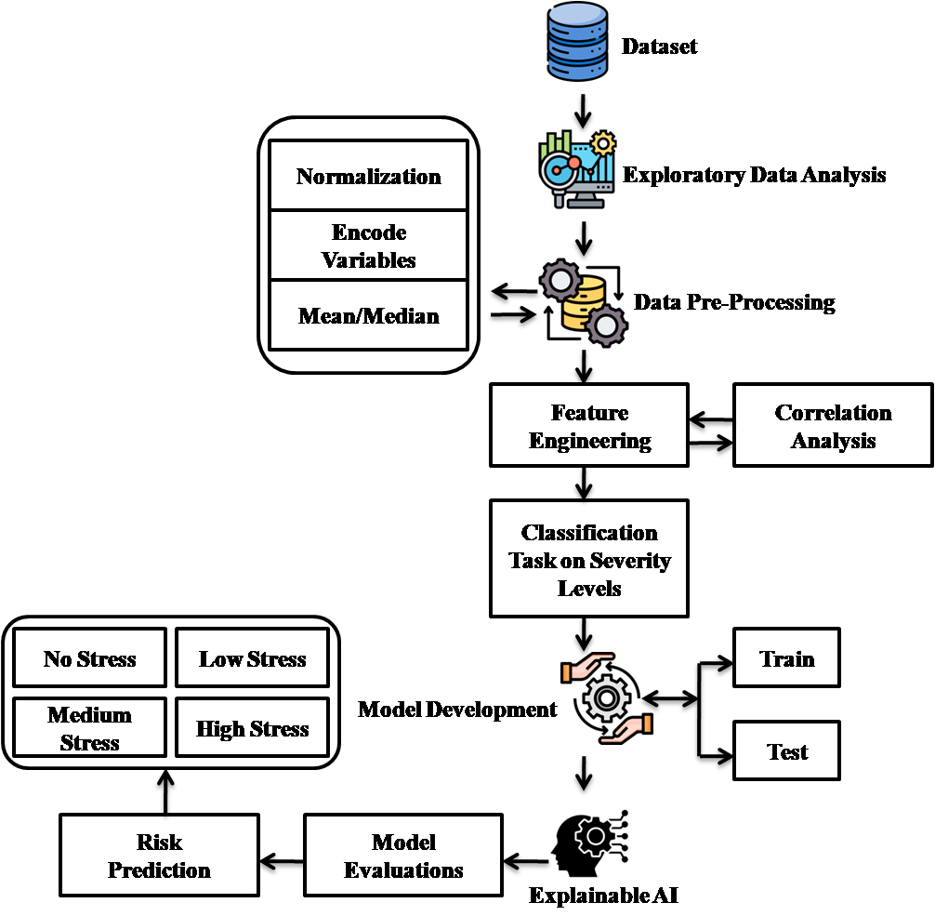
SYSTEM ARCHITECTURE

Slide 19
DATAFLOW DIAGRAM
Start
Doctor
Login
No
Pima Indian Diabetes (CSV)
Yes
Enter Parameter to Prediction
Data Preprocessing
Training
Data
Splitting
Dataset
ML-pkl Model
Validation
Data
Model
Evaluation
AI-ML Integration
Stress Level Prediction
Stop

Slide 20
SCREEN SHOTS

Slide 21
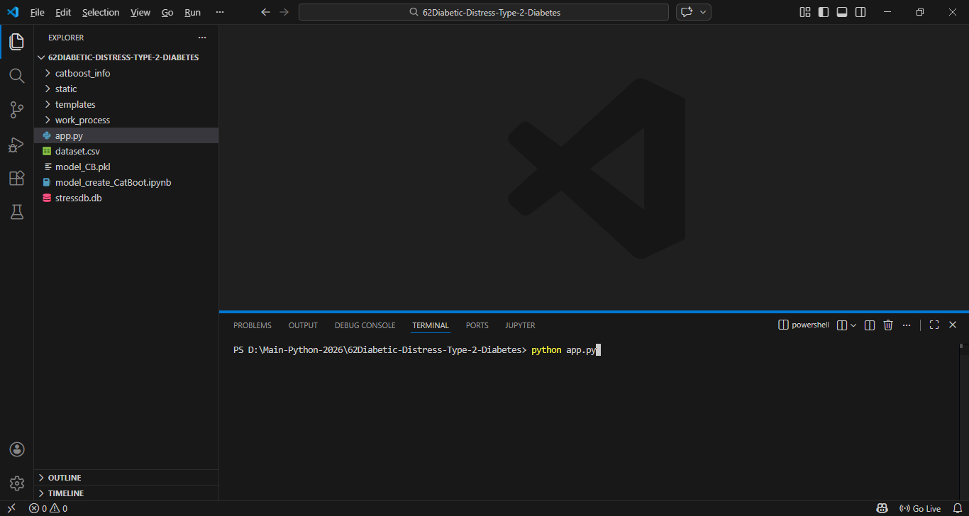
Run Flask Server CMD

Slide 22
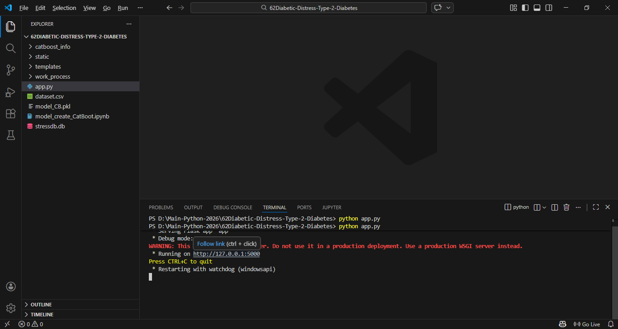
View Web Host Link

Slide 23

Main Page

Slide 24
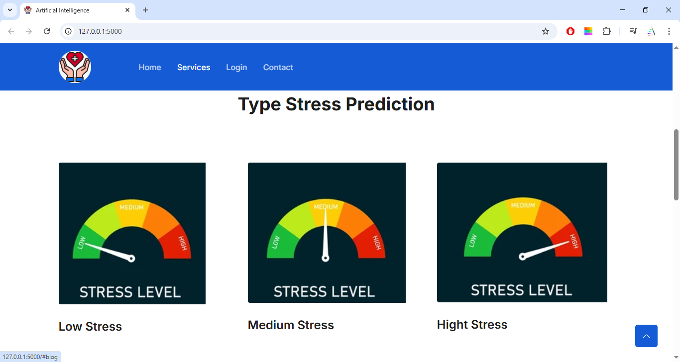
Type Stress Prediction

Slide 25
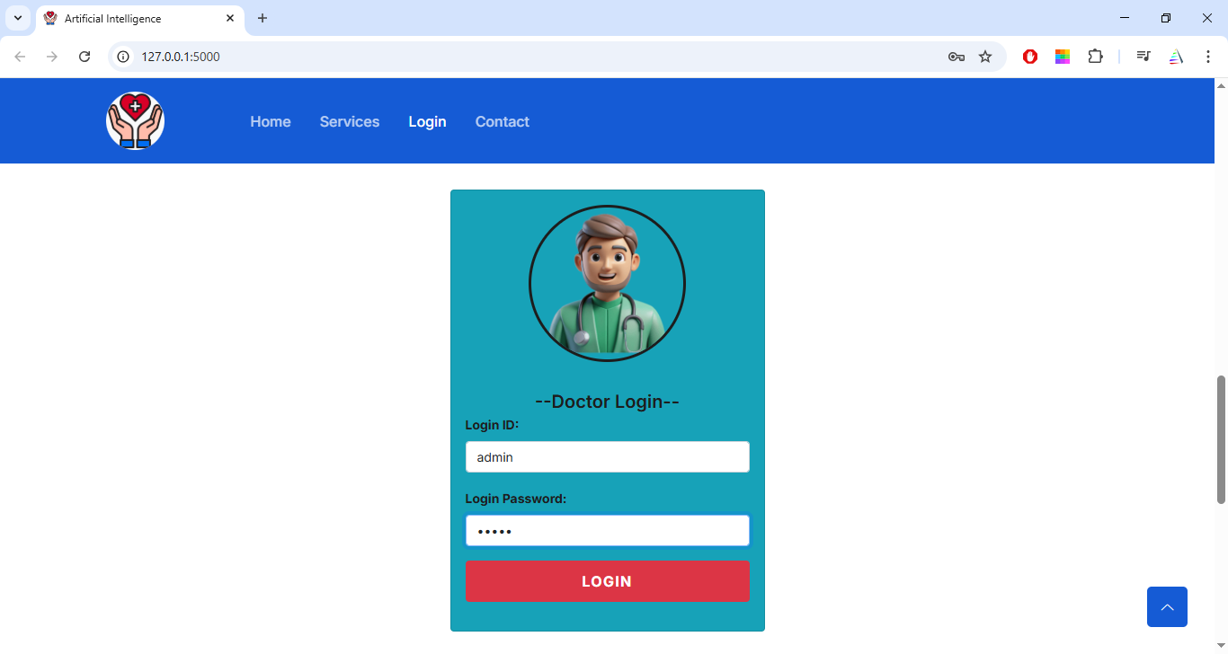
Doctor Login

Slide 26
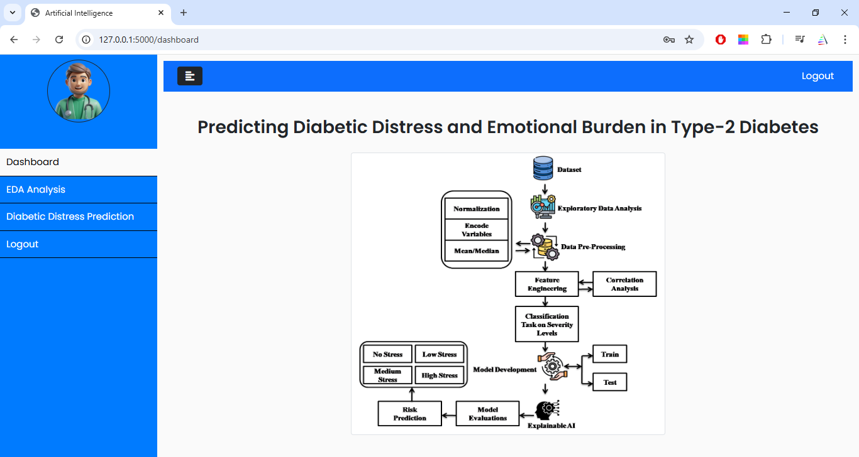
Dashboard Page

Slide 27
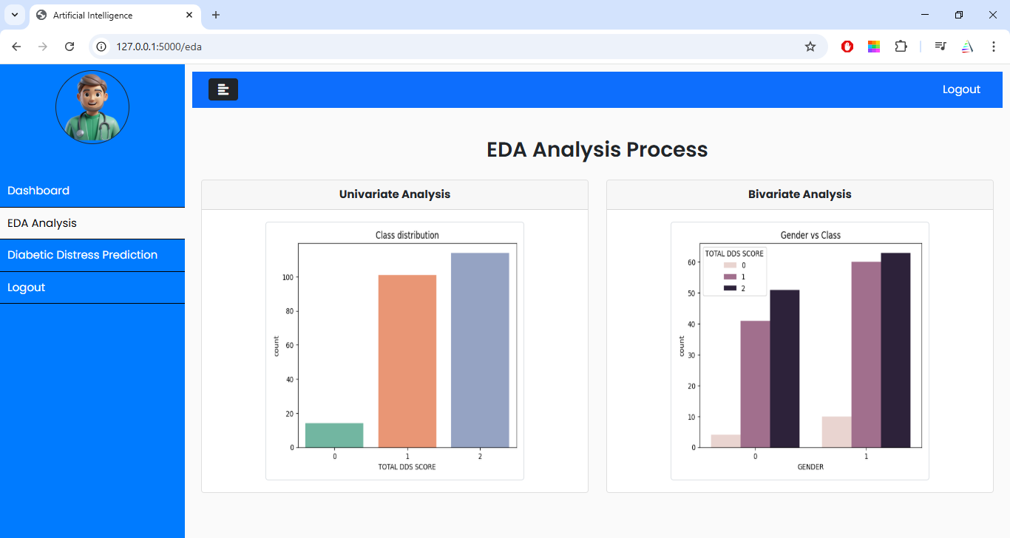
EDA Analysis

Slide 28
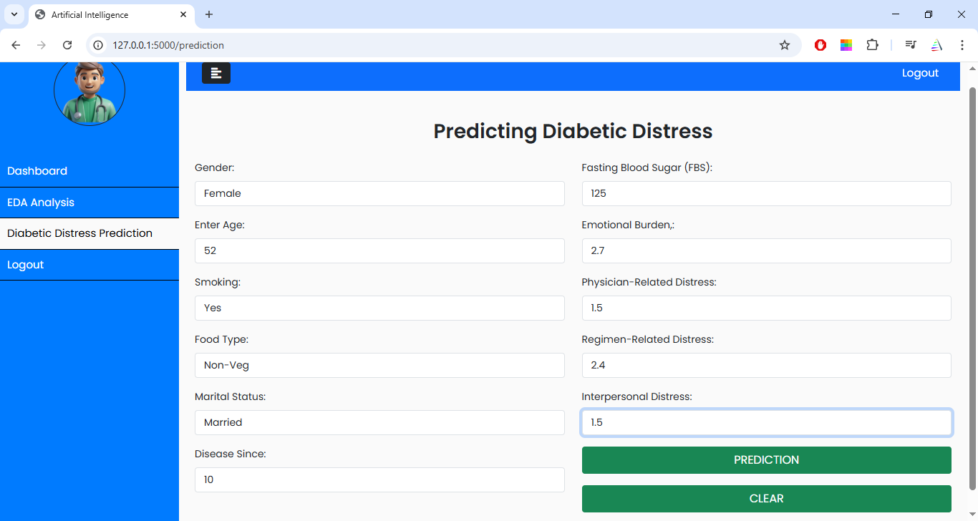
Diabetic Distress Prediction

Slide 29
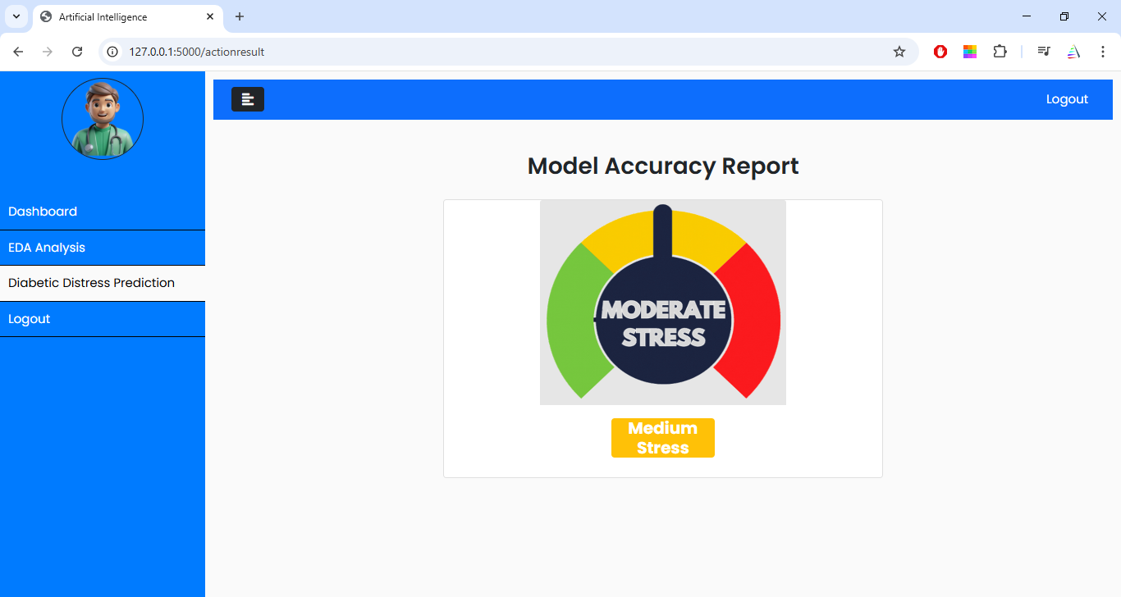
Result Prediction

Slide 30
CONCLUSION
A multimodal Machine Learning framework, by integrating demographic, clinical, and psychological features, can accurately and transparently predict diabetic distress in patients with Type-2 Diabetes Mellitus.
Among all evaluated classifiers, Extreme Gradient Boosting coupled with SHapley Additive explanations achieved the highest performance, with a classification accuracy of 96.14%, an F1-score of 0.95, and an area under the ROC curve of 0.98, while providing feature-level insights that highlight fasting blood sugar, emotional bur den and physician-related distress as the most influential predictors.

Slide 31
FUTURE WORK
Future work will involve collecting data from multiple centers to increase substantially and applying transfer learning or domain adaptation techniques to ensure that the XGBoost-SHAP model maintains performance across diverse populations.
Additionally, reliance on self-reported DDS17 scores may introduce reporting bias and might further influence distress but were not captured.
It recommends external validation on larger, multi center datasets to assess model generalizability across diverse populations and integration of longitudinal data to develop time-series models for predicting distress.

Slide 32
THANK YOU

